Slide 1
PLUG & PLAY NEWS
Sourcing, verifying and disseminating information in a real-time crisis

Slide 2
Hello!
@NikiBGD
@MaliciaRogue
@TetyUAna
Notes:
The session draws on real-life examples and first-hand accounts of reporting on crisis situations in Eastern Europe.
However, the know-how and the methods used to source, verify and make critical information available to the public in real time are applicable in similar contexts worldwide.
Couple of notes: this is a talk with Q&A not a workshop (due to the time constraints). We had to rework the structure a little bit, because of the absence of Danica. Please bear with us.
Pulling RL examples from a number of cases that took place in Eastern Europe: Ukraine’s Euromaidan protests, Bosnian protests and Balkan floods in May of 2014

Slide 3
Journalism has(n’t) changed
Informing the public
Analysis
Explaining context
Collaboration
Sources
Dissemination
Notes:
Rayna

Slide 4
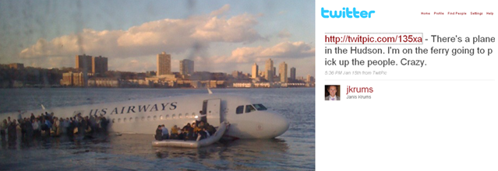
New(s) sources
January 15, 2009
Miracle on the Hudson
Notes:
Rayna

Slide 5
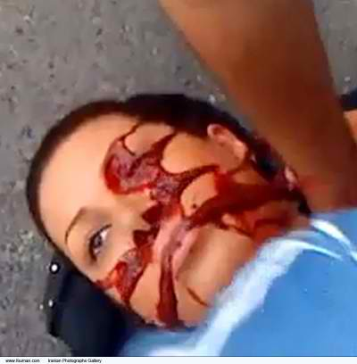
Real-time
June 20, 2009
Death of
Neda Agha-Soltan
Notes:
Rayna

Slide 6
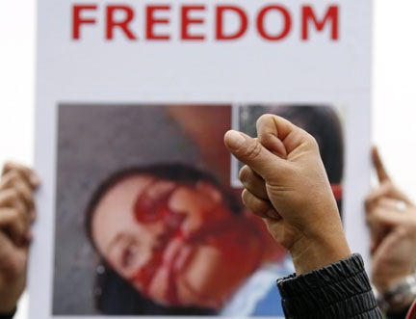
Change
June-July, 2009
The world sees a different Iran
Notes:
Rayna

Slide 7
1.
Sourcing information in a real-time crisis
Notes:
Sourcing news on social media. Focus: #Euromaidan

Slide 8
Where do I get the info from?
Traditional media
Social media
‘Human intelligence’
Authoritative opinion
First-hand accounts
Notes:
Rayna

Slide 9
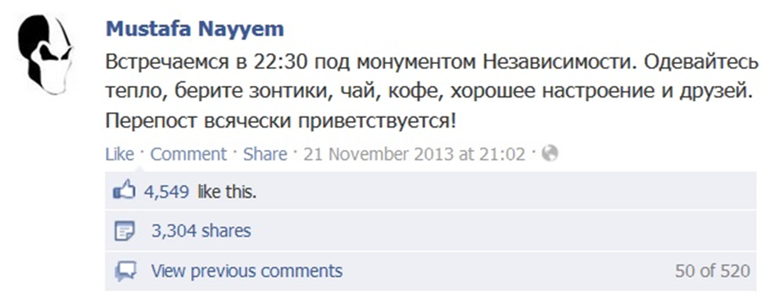
How to find ‘news’ on social media?
Know your social networks
Identify key actors
Look for users on the ground
Engage
Notes:
In the next few slides, I will pull examples from the so-called Euromaidan protests in Ukraine of 2013-2014. And while these protests are unique in many ways, I will list certain trends that have been seen in other places where protests and unrest happened, which many of you may recognize.
So, frequently, in situations like mass protests, traditional media is no longer the news-breaker, because we have thousands of social media users who are actively creating and sharing content. But how to find “news”?
Some tips:
Do some research on the social networks themselves (i.e. in Ukraine, a Russian social network Vkontakte is most popular, hailing just over 27 mln users. Facebook, on the contrary is only third when it comes to popularity, with over 3 mln users. However, if you were to search for Euromaidan-related information on Vkontakte you would get only a very small glimpse of the overall picture. Ukrainian journalists know that most traffic from social nets to major news sites comes from Facebook, as this is where the political news is mainly shared and discussed. Thus, it is not surprising that a post which sparked Euromaidan was published on Facebook and that the network has become the key online site for organizing during the protests. Note: The rise of Twitter however, largely happened in parallel with and due to Euromaidan as it has become the source of traffic for news sites only since late 2013.)
Identify who are the key actors: when speaking about protests, those could be political figures, popular journalists and bloggers and so on. As events unfold, you will also see key activists emerge online.
Alongside key actors, search for users on the ground: do not just look for hashtags! search for check-ins, photos, geotags, and so on.
Engage with users online: share interesting content, crowdsource information, etc.

Slide 10
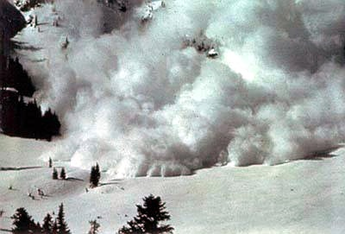
Twitter
Hashtags are useful in the beginning:
indicate scale of events
help spot key users and related tags
use for initial search, lists and aggregators
#євромайдан, #евромайдан, #euromaidan
Image in the public domain, Wikimedia Commons
Notes:
When we talk about Twitter, most people immediately think about the hashtags, right?
It is this type of metadata tag that users utilize to identify messages with specific content or theme.
And, yes,
Hashtags make it easy to see that something important is happening.
For example, as soon as pro-EU AA protests have begun in Ukraine, activists quickly adopted three tags: #Euromaidan in Ukr, Rus and Eng.
Simply following the tag would reveal the scale of events, help identify popular users (assuming they use the tags), key pieces of information and related hashtags. In the beginning it would be enough just to use the search function, create or follow aggregators (that many activists have set up), compile user lists to filter out hashtag spammers and so on.

Slide 11
Over 8,000 tweets per hour
Nearly 9,000 tweets per hour
141,000 followers within few days
22 November, 2013
1 December, 2013
@euromaidan (@EuroMaydan, @EuroMaydan_eng)
Notes:
Stats for main #euromaidan hashtag in Ukrainian demonstrate the scale of events on two key dates (the first big pro-European protest and a day after violent police crackdown on protest camp)
Stats for ‘official’ protest accounts set up on the first day of #Euromaidan

Slide 12
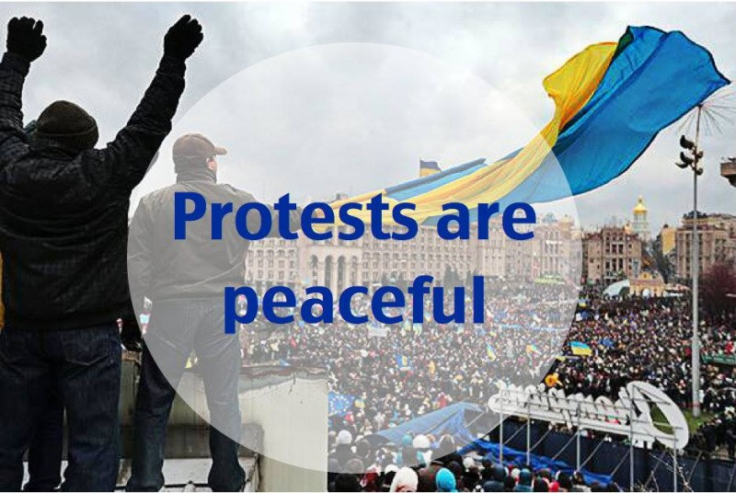
Twitter
Once the agenda is set:
users quickly consolidate around ‘official’ accounts
key media is followed anyway
Notes:
(2) However, it is important to note that researchers and media who gather information about protests using only hashtags are missing a lot of important content. As protests in Ukraine and Turkey have demonstrated, hashtags tend to be dropped once the agenda is set. Thus, in Ukraine activists have quickly consolidated their efforts around key anonymous accounts, which became the ‘official’ accounts of the protests.
And while the activists use tags mostly during initial stages of the protests, the key media outlets drop hashtags as they assume pple would follow them anyway.

Slide 13
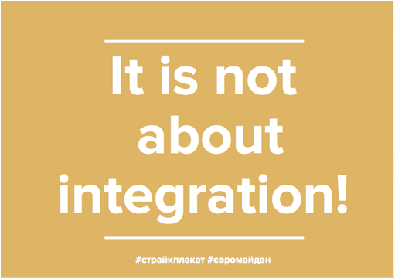
Twitter
Language barrier - no longer a problem (?)
Notes:
Social media does not only allow activists to communicate with each other, but also lets them tell their story to the world without intermediaries. This is especially true in places where domestic media is reluctant to cover such events as protests or unrest due to censorship.
The good news here is that, if something big is happening, - chances are, someone will be Tweeting in English. (This is true about other social media as well, but Twitter is, for obvious reasons, the most convenient place to provide content in numerous languages).
For example, in Ukraine, alongside ‘official’ accounts in Ukrainian/Russian an Anglophone Twitter account of the protests has been set up right away.
And here are some examples of visuals activists created in English to deliver their message, while the international media was still painting the protests in pro-Russia vs pro-European terms.

Slide 14
Facebook
Hashtags are less useful
Identify key actors
Follow “official” pages
Sign up for most popular events
Notes:
How to find important content on Facebook?
Not all users on Twitter use hashtags. On Facebook people use them even less. Do not rely on them for finding important content!
Since most of political discussions in Ukraine take place on Facebook, some of key users have emerged even before the protests began. In the age of social media it is not surprising that many of the most popular users on Facebook happened to be journalists (people well-connected to both sides of the media world), but also politicians (in our case, the opposition), political bloggers and other public opinion leaders. As events unfolded, many activists have also emerged on Facebook and became the source of important information for protests as well as the media.
Just like on Twitter, ‘official’ protest page has also been set up on Facebook and consequently broke the record in Ukraine on the speed of accumulating followers.
Another source of important information had been various Facebook ‘events’ created by users to engage people in the protests. Most popular events (with tens of thousands of ‘participants’) have provided the space for sharing important updates, instructions and so on.
Finally, if Twitter had been instrumental in informing people inside and outside Ukraine about #Euromaidan, Facebook has become the main platform for organizing (something that happened not only in Ukraine, but other places as well). Various groups ranging from those offering legal aid, medical help, supplies to protests and so on used Facebook to communicate and organize. In many cases their information was publicly available to everyone including media.

Slide 15
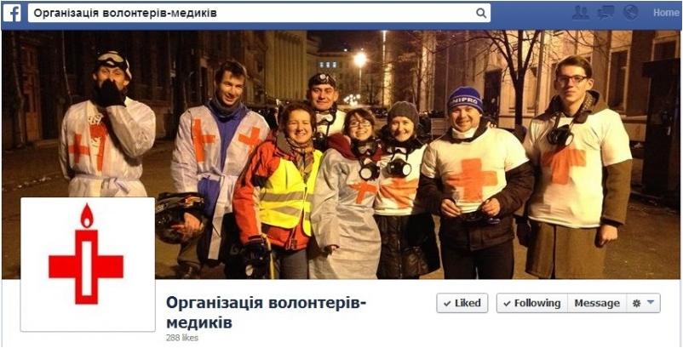
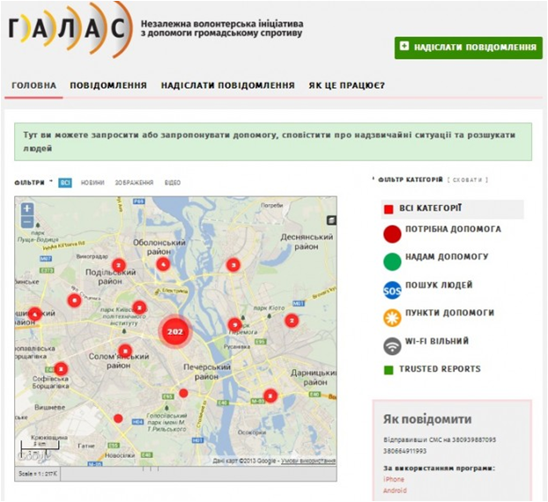
Facebook
Find groups that organize online
Notes:
Finally, if Twitter had been instrumental in informing people inside and outside Ukraine about #Euromaidan, Facebook has become the main platform for online-ofline organizing (something that happened not only in Ukraine, but other places as well). Various groups ranging from those offering legal aid, medical help, supplies to protests and so on used Facebook to communicate and organize. In many cases their information was publicly available to everyone including media.

Slide 16
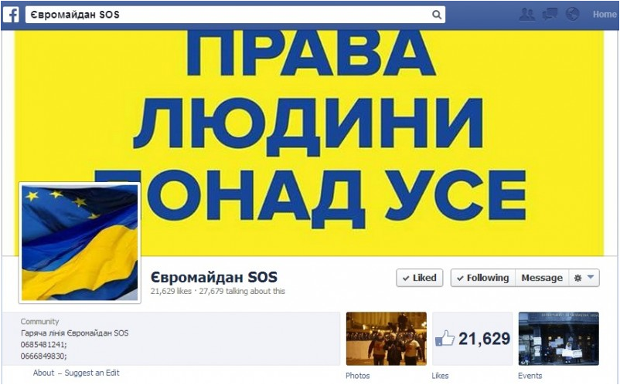
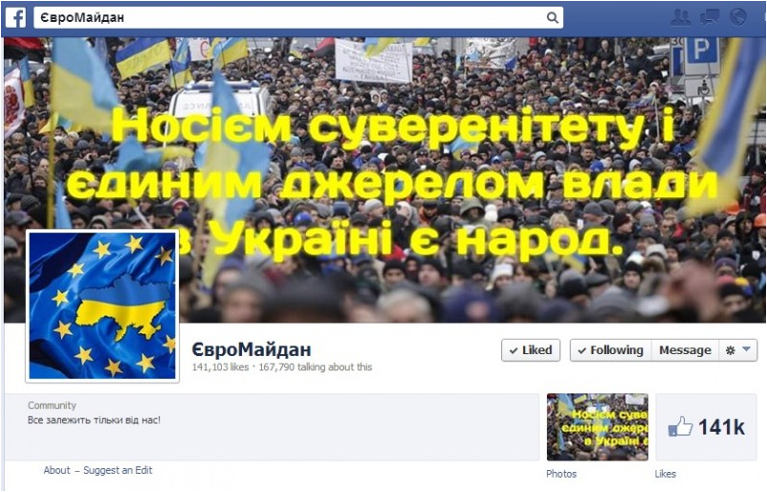
#EuromaidanSOS page and ‘official’ #Euromaidan page
Notes:
Stats on ‘official’ Facebook page: 76,000 followers in just eight days, > 200,000 followers within the first ten weeks of the protests (a record in Ukraine)
FacebookSOS - sharing information about injured in clashes with police, missing persons, and so on. Frequently a source of latest updates for activists and an information vehicle for fighting repressions.

Slide 17
Crowdsourcing content
Ask people to send you anything that might be of interest
Don’t have a network? Build it!
write about them
help connect with other media
share
Notes:
Another important way to use social media for finding important content is crowdsourcing.
Doing it is not as difficult as it may seem.
When writing about #Euromaidan I would sometimes just announce the topic I was working on at the moment on Facebook and ask people to send me anything that they found interesting. Frequently people sent me something I have already seen, but even more often they sent me things I would have missed if it weren’t for their help.
This could be done even if you do not have a network of Facebook friends or Twitter followers from a country in question. The best way to grow such network is by engaging with users. If you are a media representative, the easiest way to score some points with someone is to write about them. Especially if they are anti-government activists in a country where domestic media exercises self-censorship. Another way to engage with users is by putting them in touch with other media representatives who are interested in covering these events. Finally, if you are confident in their content you can simply share it.

Slide 18
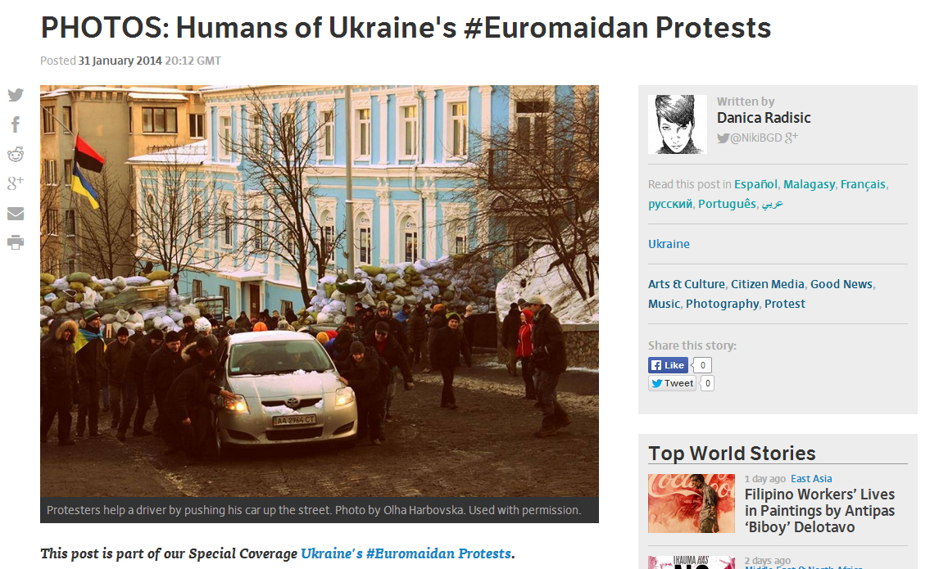
Notes:
An example of a crowdsourced post about #Euromaidan on Global Voices.
While the media all over the world was publishing pictures of the square in flames, we asked people to send us photos that would show a different side of the story (i.e. protesters playing music, decorating their tents, cooking food on Maidan, helping each other and so on. (This is a photo of protesters pushing a car up the iced street above Maidan).
This post has become quite popular.
I think it got over 700 likes on Facebook or something like that very quickly.

Slide 19
Low online presence
No/Limited Internet connection
Language barrier
Infowars/Ideological modulation of content
Hate speech

Slide 20
2.
Verifying information in a real-time crisis

Slide 21
‘Digital innocence’ does not last
Be sceptical. Be patient
know the context
livestreams
other media
own timeline, links repository, etc.
activists
Notes:
A few words of caution about the crowdsourced content (and any other content for that matter). Make your own verification attempts. Accept the fact that sometimes only traditional media outlets have the capacity to verify certain content. Cooperate!
Social media users do not have fact checking skills (at least not all of them), therefore they disseminate what they believe is true. And even in places where people are new to social media, and where in the beginning it is just your progressive crowd and the trustworthy activists… The more people join and the more they use the service, the sooner they learn to manipulate it. Problematic material may range from accidental fakes to a well-organized misinformation attempt.
We will speak about specific tools in a little bit, however, one way to spot misinformation is knowing the context well. Because of social media, often you do not even have to be physically in the place of an event to have a good understanding of what has happened. Sometimes it is enough to watch livestreams, follow reports of trusted traditional media and social media users (It is like me walking around Maidan without the computer and being like, ‘Ok, this is cool, but what’s up? what’s happening?). It is helpful to keep your own timeline of events, aggregate useful links and materials in any way convenient for you.
Sometimes activists can be of assistance in verifying crucial pieces of information. It is possible to cooperate with individual social media users or online initiatives. At other times only traditional media has the capacity to verify something by traditional means, simply because it has more resources to do so.

Slide 22
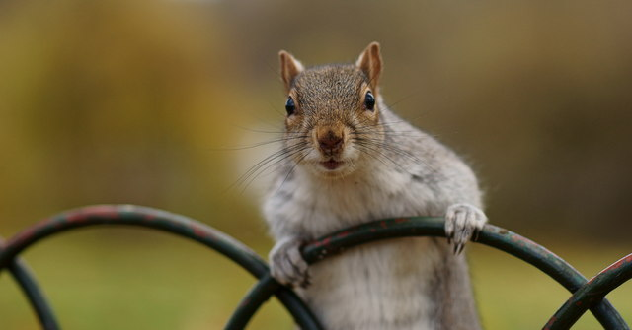
How sure are you that the info is real?
The 5Ws:
who?
where?
when?
what?
why?
Peter Trimming, CC-by-SA 2012, geography.co.uk
Notes:
Rayna

Slide 23
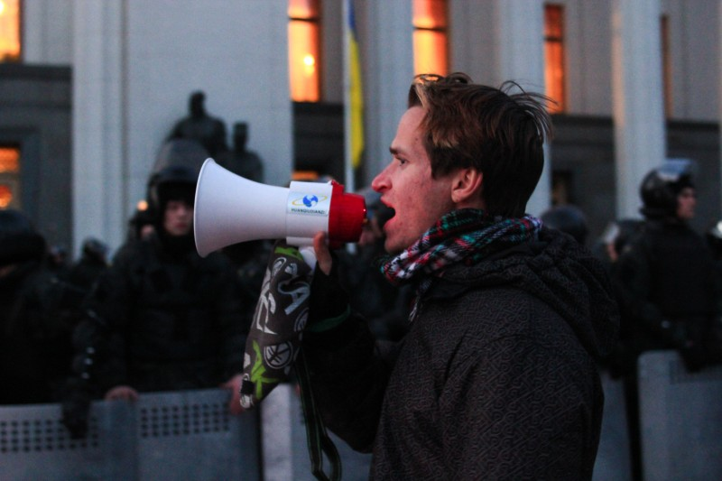
Pics or it didn’t happen (sort of)
Notes:
People believe images more
Images are relatively easy to manipulate

Slide 24
How sure are you that the image is real?
Remember the 5Ws
Some tools
Google reverse image search (find original and similar images)
TinEye (find original image, compare)
Jeffrey’s Exif Viewer (metadata if it exists)
Notes:
Rayna

Slide 25
How sure are you that the image is real?
Remember the 5Ws
Some tools
Google reverse image search (find original and similar images)
TinEye (find original image, compare)
Jeffrey’s Exif Viewer (metadata if it exists)
The magical tool does not exist
Absolute certainty vs. acceptable plausibility
Notes:
Rayna

Slide 26
‘Authoritative’ opinion
Uncertainty + anxiety = the two core elements
Fear breeds rumour
+
(Social) media stardom
Even good professionals fall to bad info

Slide 27
Beware the expert!
Case: Bosnia protests and the “violent unification” plot
The ‘Slavic’ revolution that wasn’t:
Serbian tabloid (gov’t mouthpiece)
preys on historical uneasiness
benefits wide audience
plays with ethnicity/religion
not the only such case...

Slide 28
Do the accounts belong to real people?
When was the account created?
What pictures are there?
What background information
is there?
Places
Relations
Contacts
Are there any associated accounts?
pipl.com
Facebook/LinkedIn
?
Notes:
Frequently, we we try to verify social media content, we are faced with having to verify the identity of the users that generate it.
Here, an important question to ask ourselves is do the account look like they belong to ‘real’ people.
pipl.com, Facebook search, LinkedIn
But even w/o the tools, you would not believe how much information about themselves people are sharing online!

Slide 29
How to spot a social media fake?
Case: Odessa May 2 tragedy ‘witness’ account
‘Warning signs’:
account created only 16 hrs earlier
user photo belongs to someone else
actively shared through popular resources
identical translations into various languages
Notes:
In Ukraine we have not only faced some accidental fake, but have also come across rather well-organized misinformation attempts.
A case of a fake Odessa May 2 tragedy ‘witness’ account is a good example of such an attempt.
Thus, as an aftermath of Euromaidan uprising in Kyiv, clashes between pro-Russian and pro-Ukrainian protesters took place on the streets of a Southern city of Odessa. The clashes culminated outside Odesa Trade Unions building, which then caught fire under unclear circumstances. As a result of the fire, over 40 pro-Russian activists that barricaded in the building had died.
Shortly after the tragedy, a Facebook post by an alleged emergency room doctor Igor Rogosovsky, who supposedly tried to provide medical aid to the injured inside the Trade Unions Bldng had began making rounds on Facebook. Acc to the doctor’s account, he’d been prevented from tending to the dying person by the pro-Ukrainain “combatants”, who then threatened him and other Jews of Odesa with physical violence.
This horrifying story has been shared over 2,000 times in just 15 hrs and continued gaining popularity.
However, upon examining it closer, some users have noted that an account of alleged emergency room doctor has been set up only 16hrs earlier and contained no other information about his life in Odesa before May 2014 events. Moreover, a simple search revealed that his profile photo has actually belonged to another doctor - a dentist from Karachaevo-Cherkessia, Russia.
Other ‘warning signs’ about the content included it being actively shared through popular groups and pages, and, when it became popular enough, translations into different languages had been shared on international media pages and news sites. The story was also shared in Jewish online communities and in comment sections on news sites. Curiously, the translations into different languages shared by different users were seemingly identical.
Whoever was behind this fake was interested in aiding a narrative popular with Russian and other foreign media that often painted EuroMaidan protesters as far-right radicals.
The page of the alleged doctor from Odesa has since been removed.
http://blogs.pravda.com.ua/authors/savanevsky/5365f834c31e7/

Slide 30
3.
Disseminating information in a real-time crisis

Slide 31
Correct information, wrong time
Tweets and Facebook updates remain online:
sharing continues despite timestamp;
call for action active;
mobilisation continues...
May have direct negative impact on situation on the ground

Slide 32
Disseminating and publishing
Towards the ‘outside’:
Wordpress blog: main content point;
Ushahidi map: incoming damaged areas and emergencies
Twitter + Facebook: to share further
Erase social media updates if no longer applicable

Slide 33
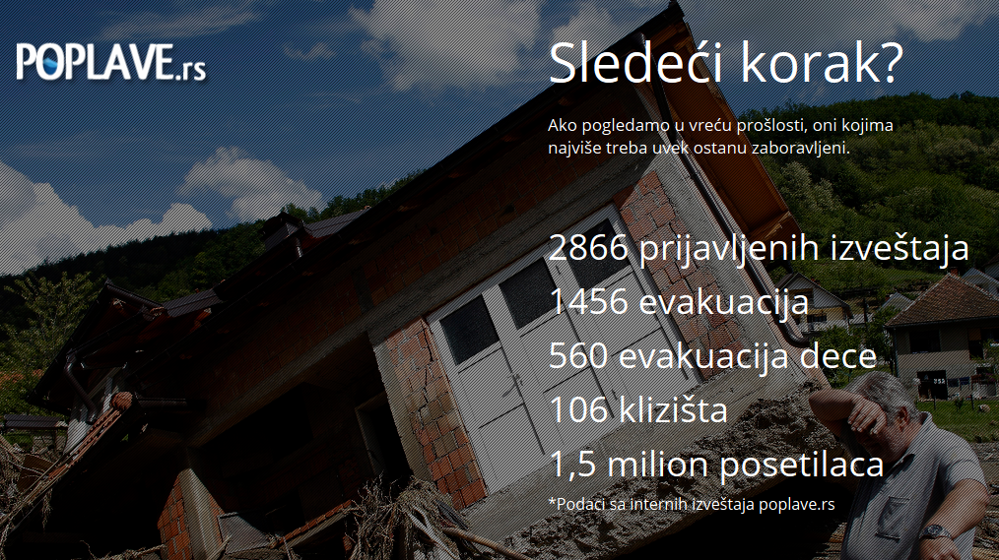
In practice
Within the relief team members:
Several separate Skype group conversations for several topics,
A closed Facebook group to coordinate verification of incoming information
Enure need of information is communicated ASAP to both team and public

Slide 34
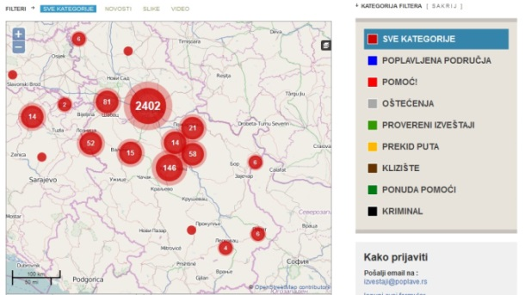
Get organised from the start
assign tasks and roles
define communication channels
know who is where at each moment of shift
define what each tool is used for
identify reliable contacts on the ground + work with Red Cross

Slide 35
Key takeaways

Slide 36
Sourcing, verifying, publishing
Look in the right places
Assume it is fake until proven otherwise
Beware of the limits of technology
low tech in disaster context
verification on the ground is crucial in most cases
Right info, right time & the right platform

Slide 37
KEEP LISTENING.
KEEP DOUBTING.
KEEP CHECKING.
KEEP LEARNING.
KEEP SHARING.
@NikiBGD

